Slide 1
7 Algorithm design and problem-solving
Other standard methods of a solution

Slide 2


Standard methods of a solution
You need to be aware of the following standard methods that are commonly used when programming:
Totalling
Counting
Finding maximum, minimum and average values
Searching using a linear search
Sorting using a bubble sort
Covered in more detail in the following videos:
7 Linear search
7 Bubble sort

Slide 3
Totalling
Totalling refers to maintaining a total that values are added to.
There are many situations where you might want to use totalling in your programs – for example, keeping a running total of marks awarded to a student during a test.
Total ß 0
FOR Counter ß 1 TO MaxNoOfQuestionsInTest
Total ß Total + StudentsTest[Counter]
NEXT counter

Slide 4
Totalling
Totalling refers to maintaining a total that values are added to.
There are many situations where you might want to use totalling in your programs – for example, keeping a running total of marks awarded to a student during a test.
It is good practice to always initialise variables, so here we start by setting total to zero.
Total ß 0
FOR Counter ß 1 TO MaxNoOfQuestionsInTest
Total ß Total + StudentsTest[Counter]
NEXT counter

Slide 5

Totalling
Totalling refers to maintaining a total that values are added to.
There are many situations where you might want to use totalling in your programs – for example, keeping a running total of marks awarded to a student during a test.
It is good practice to always initialise variables, so here we start by setting total to zero.
Total ß 0
FOR Counter ß 1 TO MaxNoOfQuestionsInTest
Total ß Total + StudentsTest[Counter]
NEXT counter
This line is performing totalling by adding together the marks held in an array called StudentsTest.

Slide 6
Counting
Keeping count of the number of times a particular action is performed (i.e., the number of times you iterate through a loop) is another very common action performed in programs – for example, counting up the number of students that have been awarded a pass mark in a test.
PassCount ß 0
FOR Counter ß 1 TO ClassSize
INPUT StudentMark
IF StudentMark > 50
THEN
PassCount ß PassCount + 1
ENDIF
NEXT Counter

Slide 7
Counting
Keeping count of the number of times a particular action is performed (i.e., the number of times you iterate through a loop) is another very common action performed in programs – for example, counting up the number of students that have been awarded a pass mark in a test.
It is good practice to always initialise variables, so here we start by setting PassCount to zero.
PassCount ß 0
FOR Counter ß 1 TO ClassSize
INPUT StudentMark
IF StudentMark > 50
THEN
PassCount ß PassCount + 1
ENDIF
NEXT Counter

Slide 8
Counting
Keeping count of the number of times a particular action is performed (i.e., the number of times you iterate through a loop) is another very common action performed in programs – for example, counting up the number of students that have been awarded a pass mark in a test.
PassCount ß 0
FOR Counter ß 1 TO ClassSize
INPUT StudentMark
IF StudentMark > 50
THEN
PassCount ß PassCount + 1
ENDIF
NEXT Counter
If the StudentMark input is greater than 50, we need to update the count.

Slide 9
Counting
We can count down as well as up, and there are many reasons why you might want to do this in a program – for example, a retailer keeping track of how much stock they have left so they know when to put in an order.
...
StockAvailable ß StockAvailable - 1
IF StockAvailable < 10
THEN
CALL OrderNewStock()
...
In this line, we are counting down by decreasing the value held in the StockAvailable variables.

Slide 10
Maximum, minimum and average
Being able to find the largest and smallest values in a data set is another common technique used in algorithms – for example, finding the highest and lowest marks awarded to students in a class.
MaximumMark ß 0
MinimumMark ß 100
FOR Counter ß 1 TO ClassSize
IF StudentMark[Counter] > MaximumMark
THEN
MaximumMark ß StudentMark[Counter]
ENDIF
IF StudentMark[Counter] < MinimumMark
THEN
MinimumMark ß StudentMark[Counter]
ENDIF
NEXT Counter

Slide 11
Maximum, minimum and average
Being able to find the largest and smallest values in a data set is another common technique used in algorithms – for example, finding the highest and lowest marks awarded to students in a class.
MaximumMark ß 0
MinimumMark ß 100
FOR Counter ß 1 TO ClassSize
IF StudentMark[Counter] > MaximumMark
THEN
MaximumMark ß StudentMark[Counter]
ENDIF
IF StudentMark[Counter] < MinimumMark
THEN
MinimumMark ß StudentMark[Counter]
ENDIF
NEXT Counter
Initialise the maximum to the lowest possible mark and the minimum to the highest possible mark.

Slide 12
Maximum, minimum and average
Being able to find the largest and smallest values in a data set is another common technique used in algorithms – for example, finding the highest and lowest marks awarded to students in a class.
MaximumMark ß 0
MinimumMark ß 100
FOR Counter ß 1 TO ClassSize
IF StudentMark[Counter] > MaximumMark
THEN
MaximumMark ß StudentMark[Counter]
ENDIF
IF StudentMark[Counter] < MinimumMark
THEN
MinimumMark ß StudentMark[Counter]
ENDIF
NEXT Counter
Check the current value in the StudentMark array and see if it is higher than the value currently stored in MaximumMark or lower than the value currently stored in MinimumMark.

Slide 13
Maximum, minimum and average
Being able to find the largest and smallest values in a data set is another common technique used in algorithms – for example, finding the highest and lowest marks awarded to students in a class.
MaximumMark ß 0
MinimumMark ß 100
FOR Counter ß 1 TO ClassSize
IF StudentMark[Counter] > MaximumMark
THEN
MaximumMark ß StudentMark[Counter]
ENDIF
IF StudentMark[Counter] < MinimumMark
THEN
MinimumMark ß StudentMark[Counter]
ENDIF
NEXT Counter
If either of these statements are true, replace the maximum or minimum mark currently stored with the new one.

Slide 14
Maximum, minimum and average
Following on from the totalling method we looked at earlier, it is also very common to calculate the average (mean) of a set of values – for example, the average number of marks achieved in a test.
Total ß 0
FOR Counter ß 1 TO MaxNoOfQuestionsInTest
Total ß Total + StudentsTest[Counter]
NEXT counter
Average ß Total / MaxNoOfQuestionsInTest
Here we calculate the average from the total after the loop has completed.

Slide 15
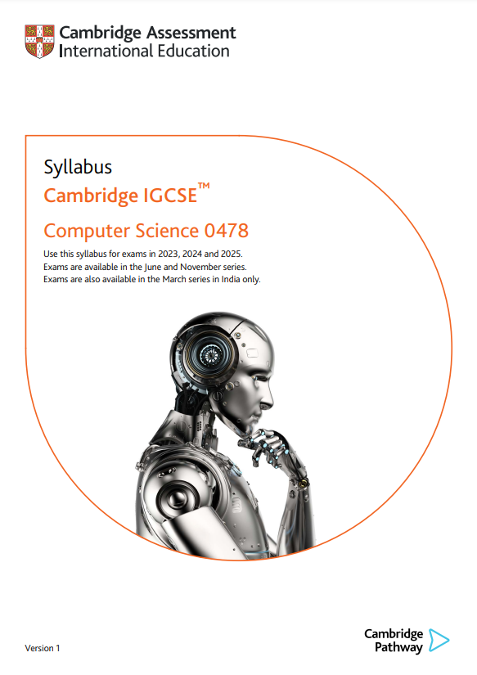
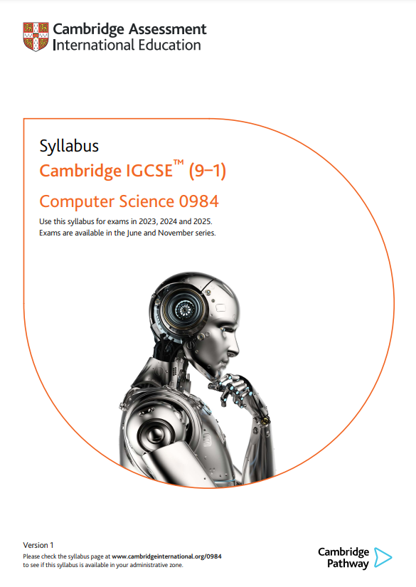

Cambridge IGCSE pseudocode
The pseudocode in these videos follows the exact style that will be used in the exams.
The full set of pseudocode is defined in the syllabus:
Cambridge IGCSE (9-1) Computer Science – 0984
Cambridge IGCSE (A*-G) Computer Science – 0478

Slide 16


